Slide 1

Yên Phong 2024
PORCELAIN TILES MATT 800x800

Slide 2




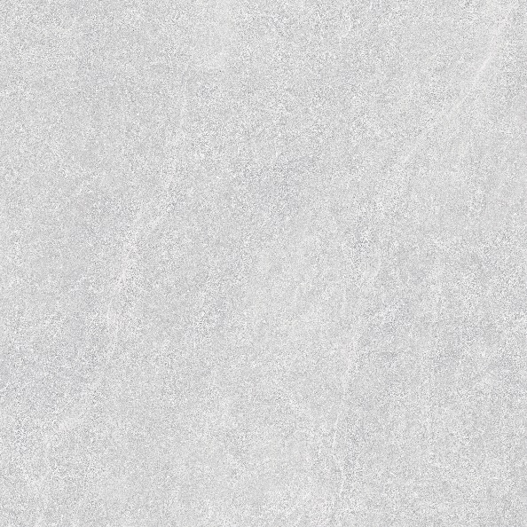

800mm x 800mm SEMI PORCELAIN
Code: UM801 800mm x 800mm/ Semi Porcelain/matt/ 05 face

Slide 3
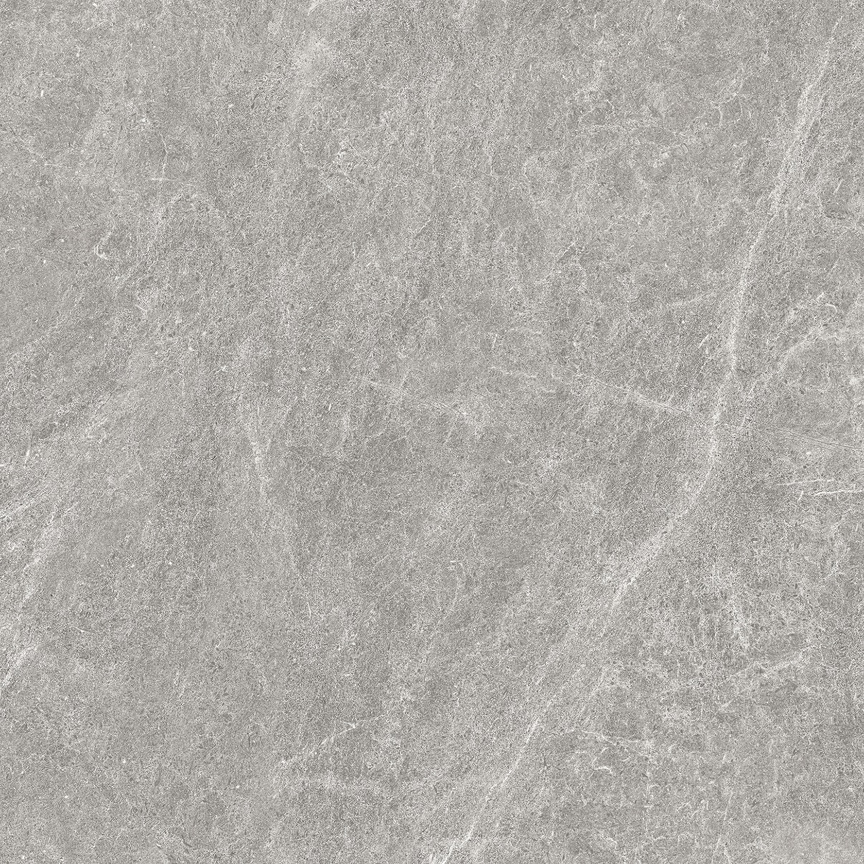
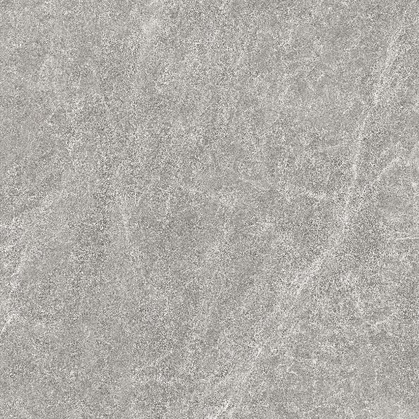
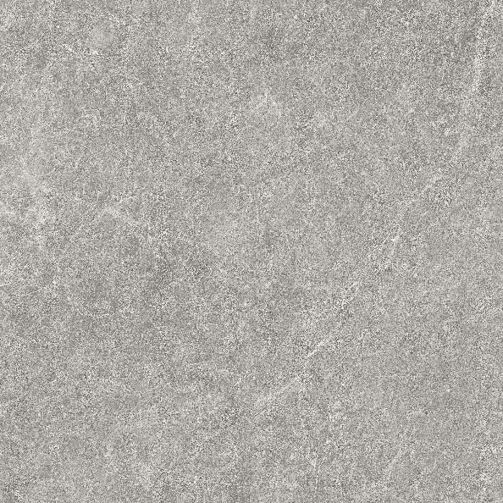
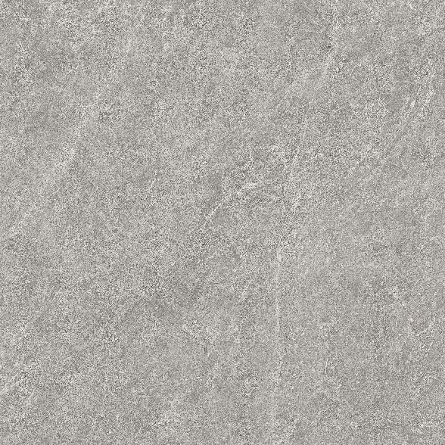
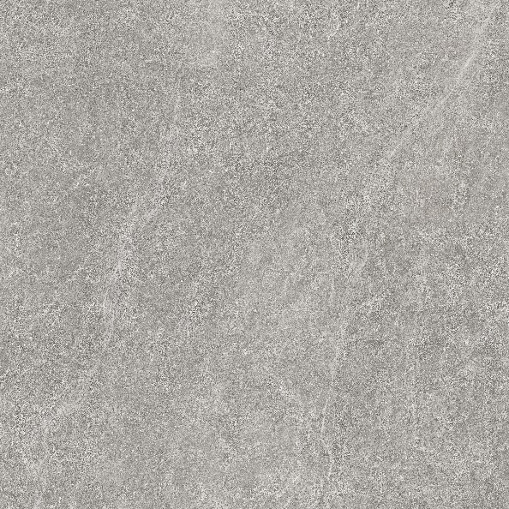
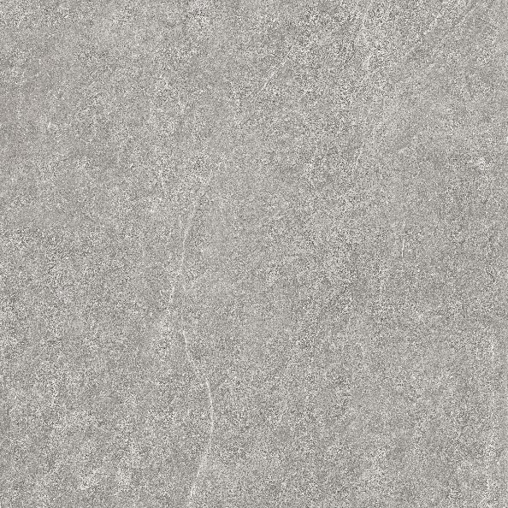
800mm x 800mm SEMI PORCELAIN
Code: UM802 800mm x 800mm/ Semi Porcelain/matt/ 05 face

Slide 4
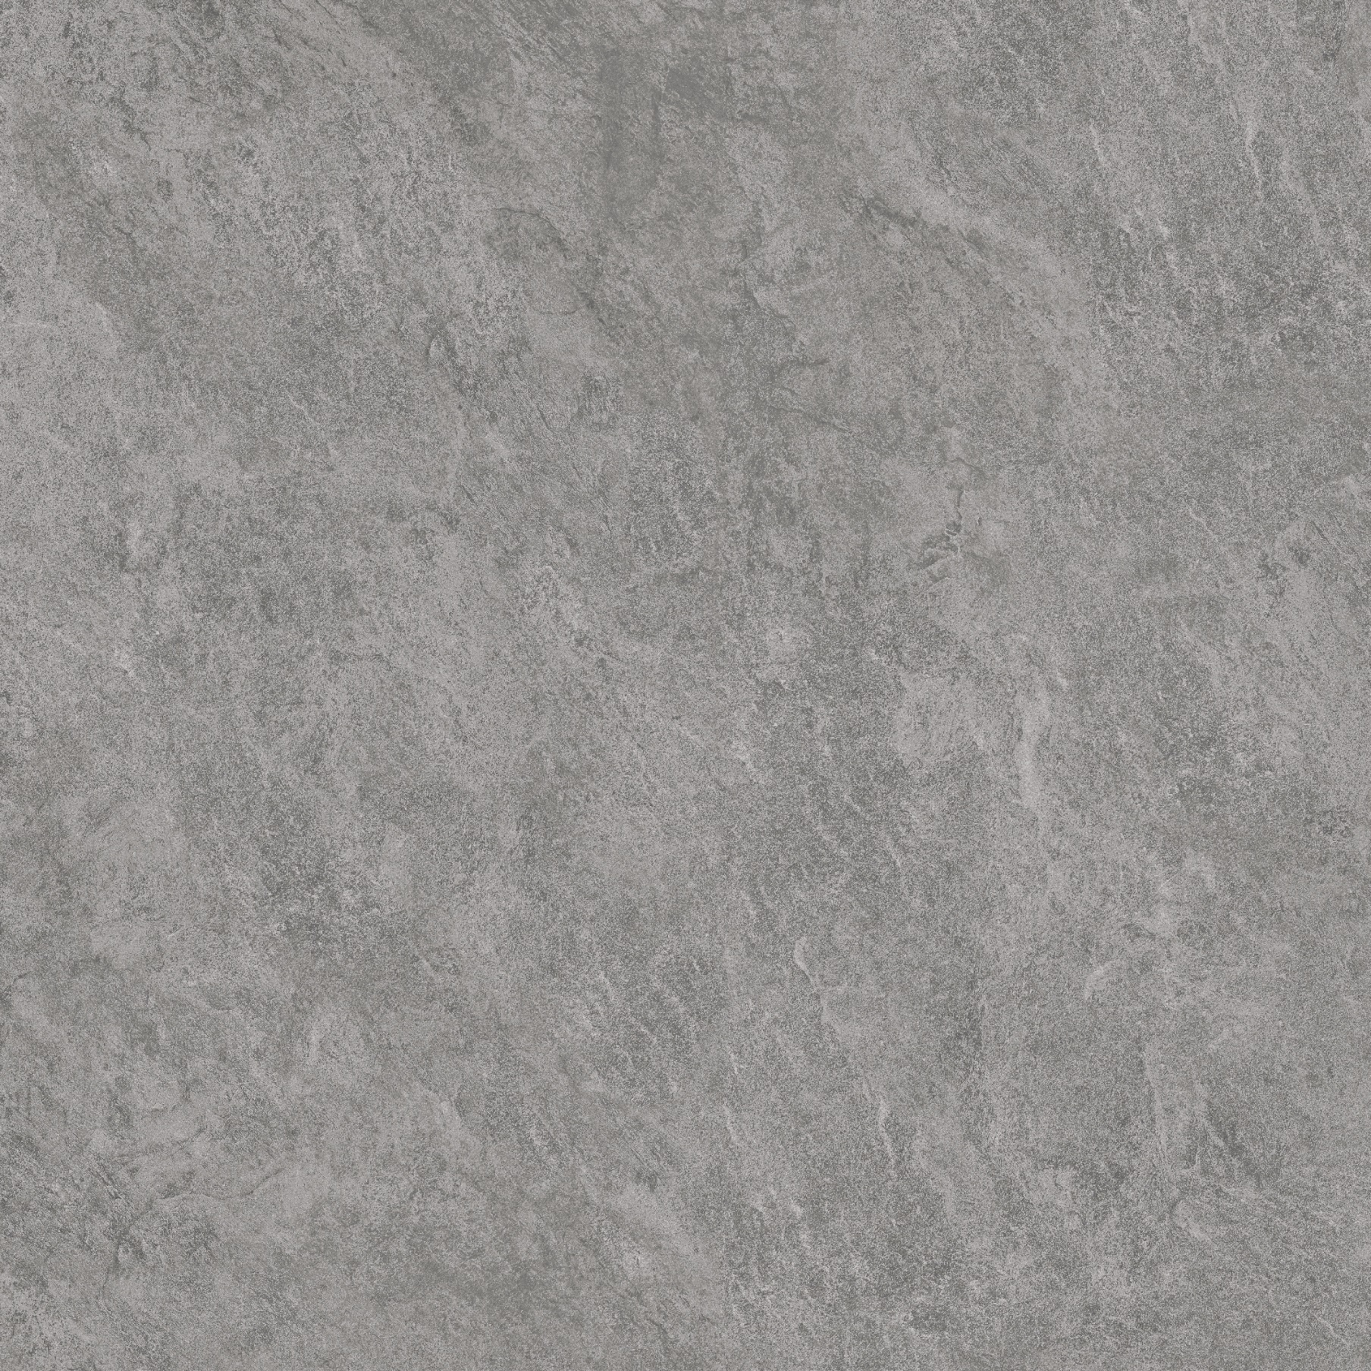
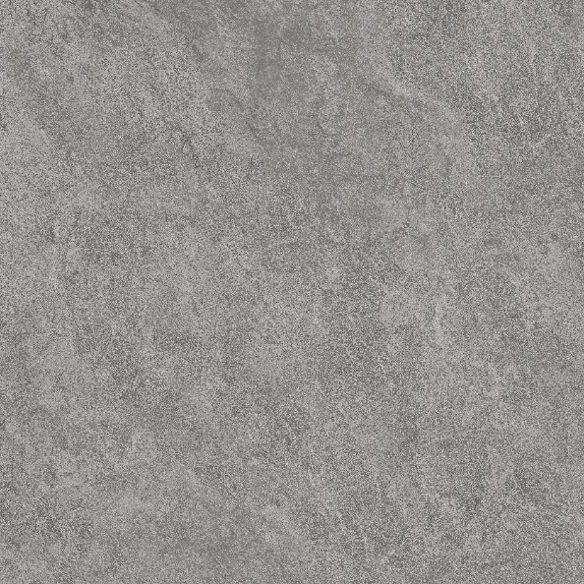
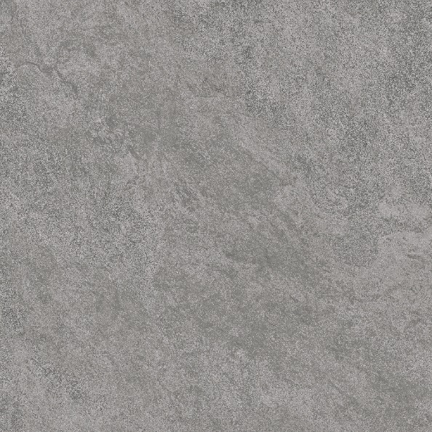
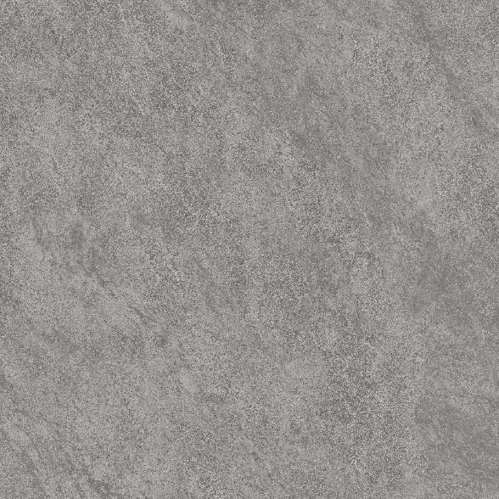
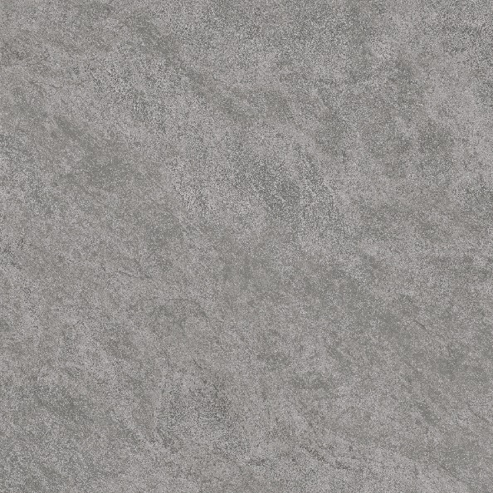
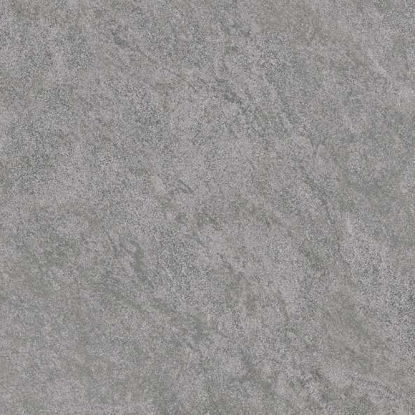
800mm x 800mm SEMI PORCELAIN
Code: UM803 800mm x 800mm/ Semi Porcelain/matt/ 05 face

Slide 5






800mm x 800mm SEMI PORCELAIN
Code: UM804 800mm x 800mm/ Semi Porcelain/matt/ 05 face

Slide 6






800mm x 800mm SEMI PORCELAIN
Code: UM805 800mm x 800mm/ Semi Porcelain/matt/ 05 face

Slide 7
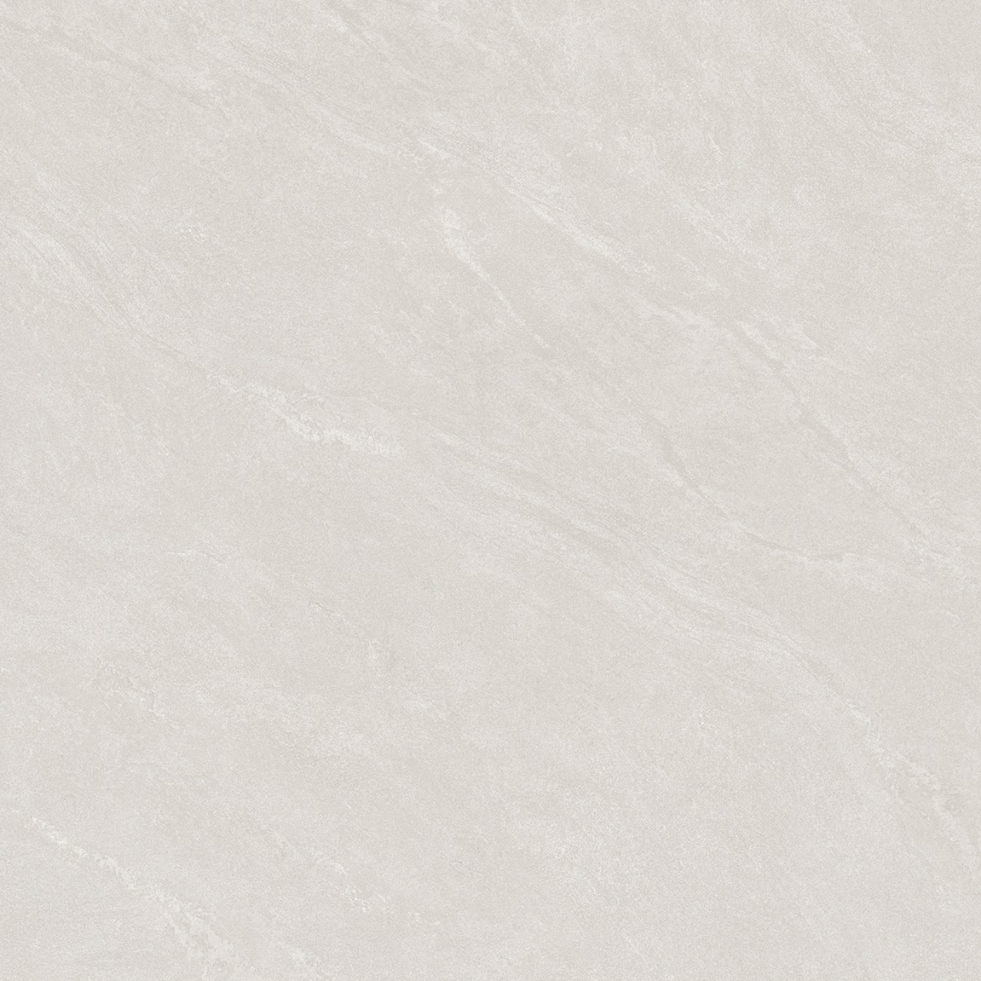
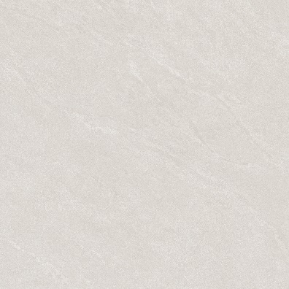
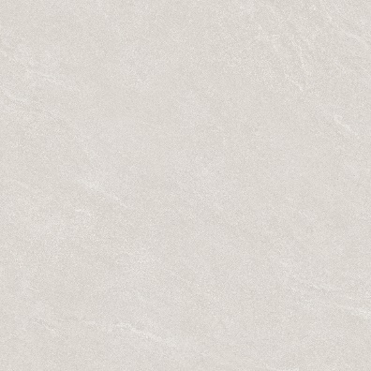



800mm x 800mm SEMI PORCELAIN
Code: UM821 800mm x 800mm/ Semi Porcelain/matt/ 05 face

Slide 8

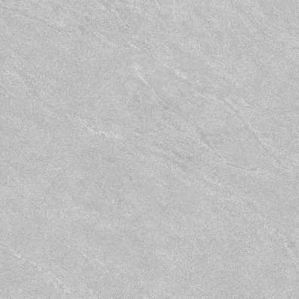

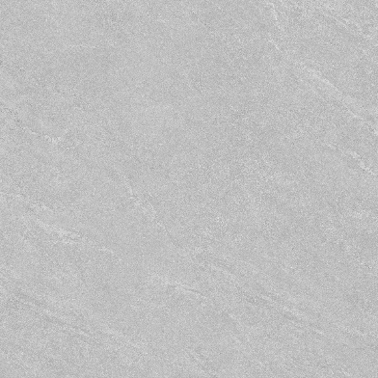

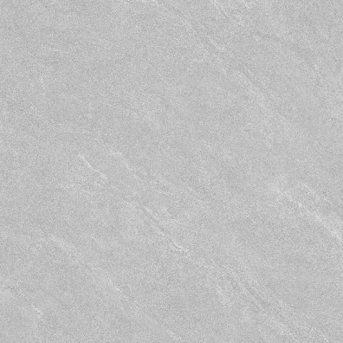
800mm x 800mm SEMI PORCELAIN
Code: UM822 800mm x 800mm/ Semi Porcelain/matt/ 05 face

Slide 9
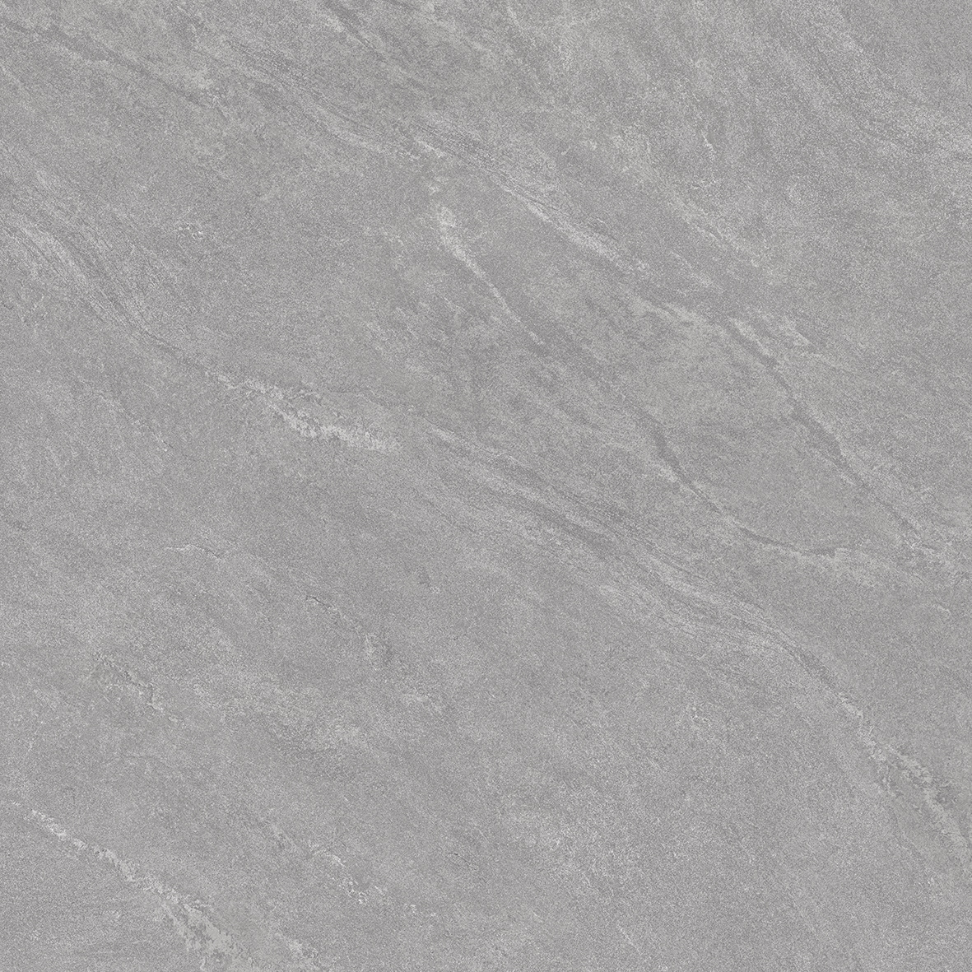
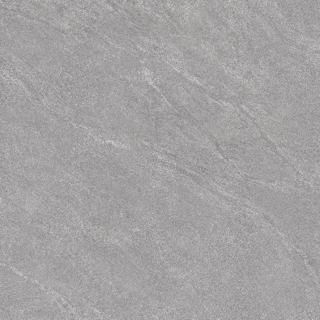
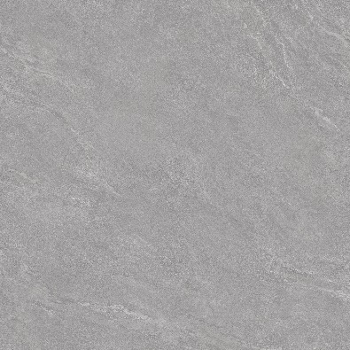
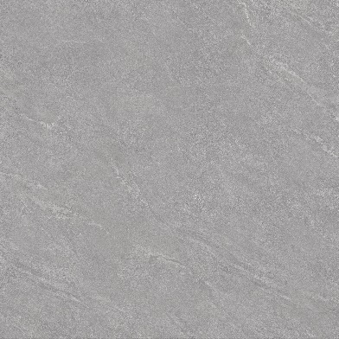
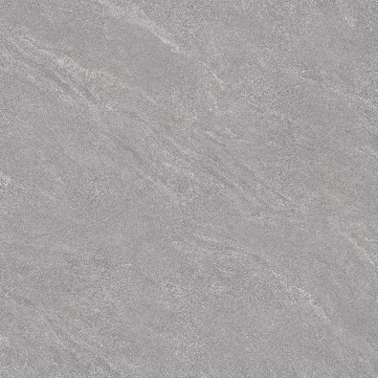
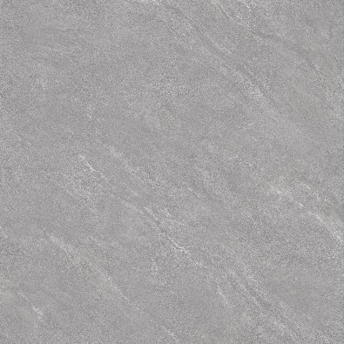
800mm x 800mm SEMI PORCELAIN
Code: UM823 800mm x 800mm/ Semi Porcelain/matt/ 05 face

Slide 10






800mm x 800mm SEMI PORCELAIN
Code: UM824 800mm x 800mm/ Semi Porcelain/matt/ 05 face

Slide 11






800mm x 800mm SEMI PORCELAIN
Code: UM825 800mm x 800mm/ Semi Porcelain/matt/ 05 face

Slide 12
THANK YOU

